Slide 1

Windows
&
Window Treatments

Slide 2
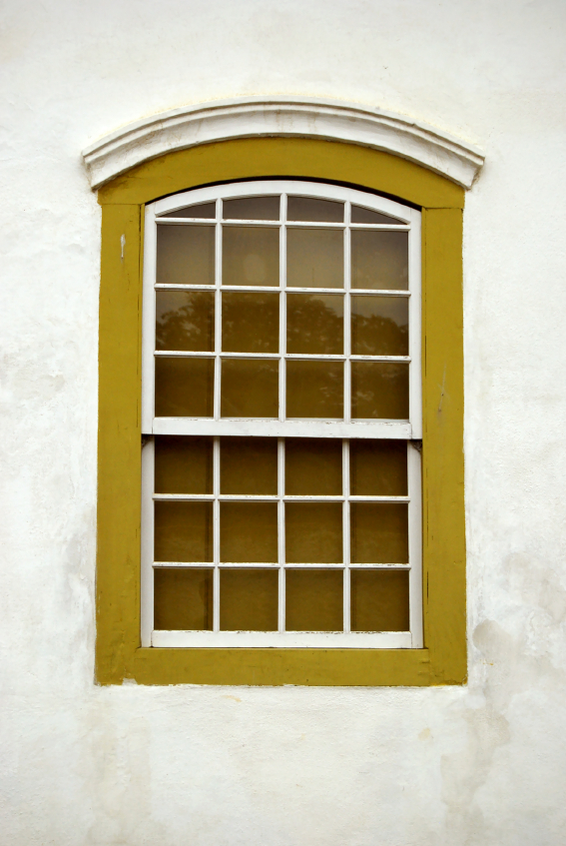
What’s the Purpose of a Window?
Light Admission
Ventilation
Visual Communication
Aesthetics

Slide 3
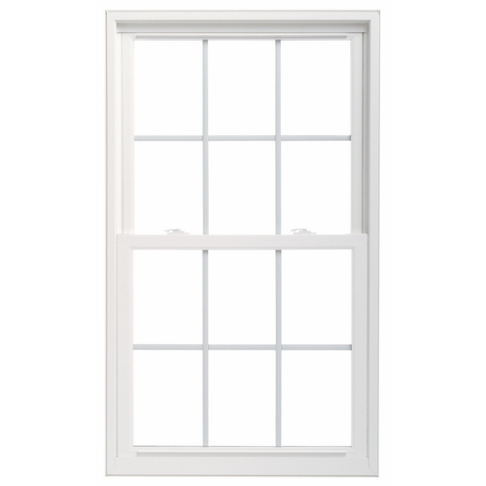
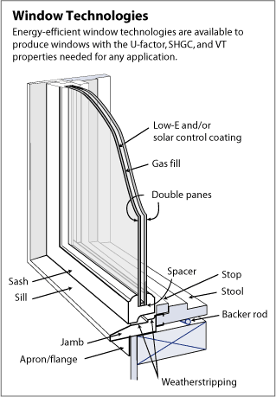
Parts of a Window
Grilles
Lock Latch
Casing
Sash
Rail

Slide 4
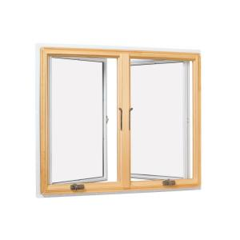
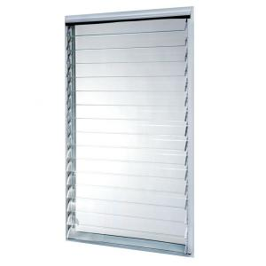
Types of Windows
Casement
Jalousie

Slide 5
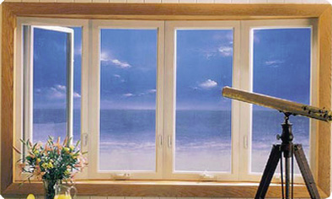
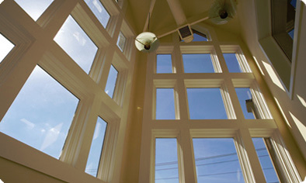
Types of Windows
Bay
Picture
Windows that do not open

Slide 6
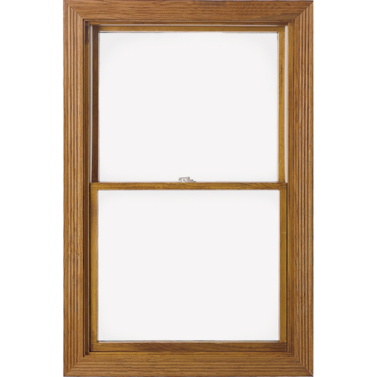
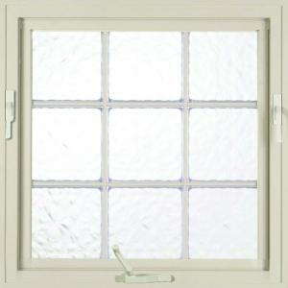
Types of Windows
Double Pane
Awning Window

Slide 7
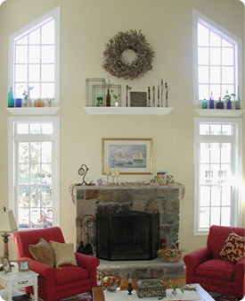
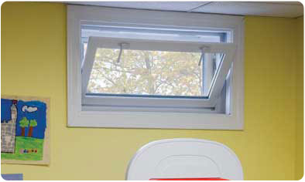
Types of Windows
Hopper
Designer Shapes

Slide 8
How to Select a Window Treatment
Basic Window Type
Needs like privacy, air, light
Durability
Safety – flame resistant & child safety
Ease & Cost of care
Construction
Beauty- color, design, style
Mood of the room & furnishings
Form

Slide 9
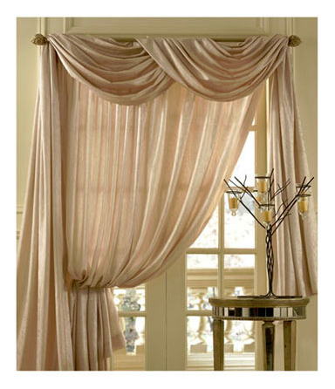
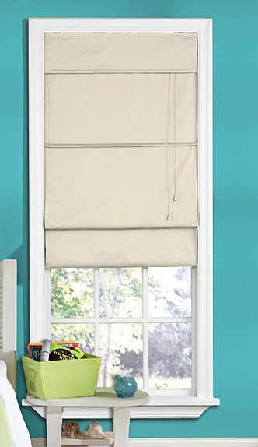
Types of Window Treatments
Roman Shade
Swag

Slide 10
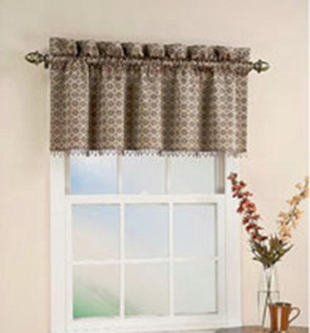
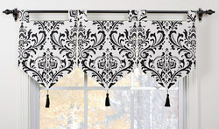
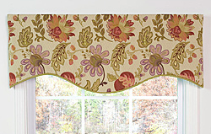
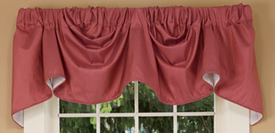
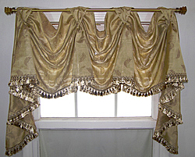
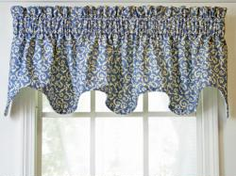
Types of Valances
Banner Valance
Shaped Valance
Austrian Valance
Scalloped Valance
Swag Valance

Slide 11
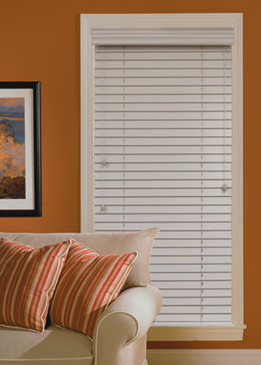
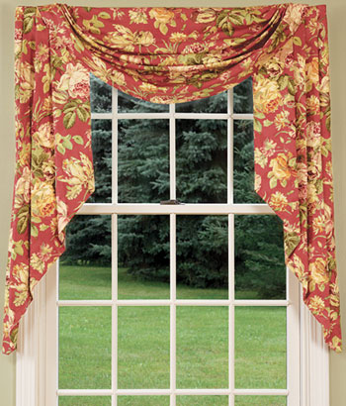
Types of Window Treatments
Blinds
Jabots

Slide 12
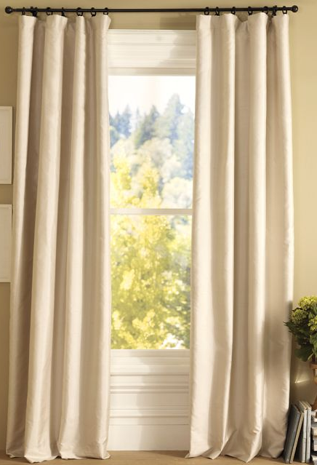

Drapes Vs. Curtains
Drapes
Curtains
Heavy
Lined
Floor Length
Light Weight
Unlined
Vary in length

Slide 13
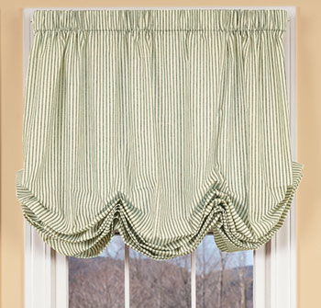
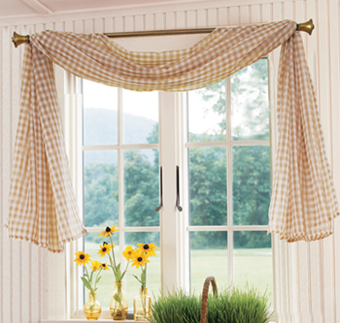
Types of Window Treatments
Balloon Curtain
Swag

Slide 14
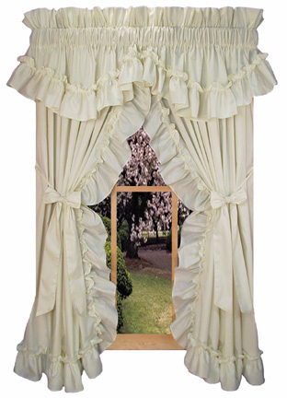
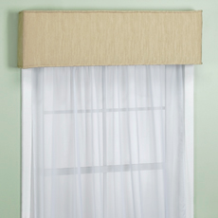
Types of Window Treatments
Priscilla
Cornice

Slide 15
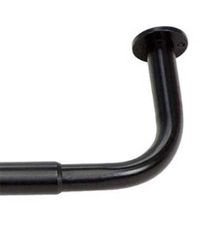
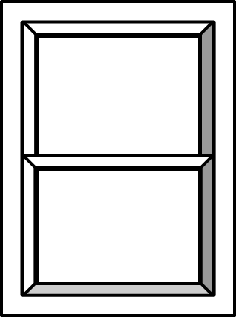
How to Measure fabric for Curtains
Curtain Rod
overlap
Rod Measurement
Return Measurement X 2
Overlap Measurement x 2
Side Hems Measurement x 2
Total Measurement x 2
Take the total measurement divide by width of material (Ex. 36” =3ft or 60”=5ft)
Multiple step 6 by the length of the window
*Remember to add 12” to the finished length of the window
Return
Finished Length

Slide 16
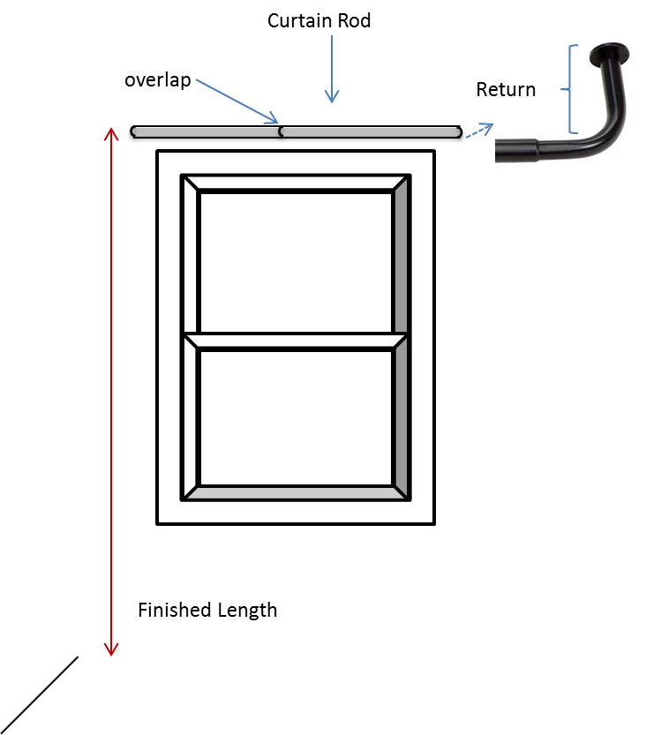

Calculate the Yardage for Drapes
Rod Measurement
Return Measurement X 2
Overlap Measurement x 2
Side Hems Measurement x 2
Total Measurement x 2
Take the total measurement divide by width of material (Ex. 36” =3ft or 60”=5ft)
Multiple step 6 by the length of the window
*Remember to add 12” to the finished length of the window
5’6”
4”
4”
Fabric 50” Wide
7’

Slide 17

Window Treatment
Project
Create a 8.5” x 11” window treatment board displaying 6 different options for this window.
The window treatments should be three dimensional and no repeats.
Be creative use lace, fabric, trims, cardboard, etc.

Slide 18
Works Cited
US Department of Energy
Pella Windows
Country Curtains
HomeDepot.com
Lowes.com

