Slide 1
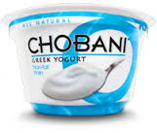
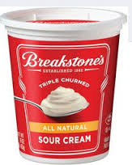
Use This, Not That
One Tbsp.= 8 calories, 3 g. protein, 2% calcium, 0 g. fat. Excellent for digestive health; probiotics, helps control blood pressure, good for bone health & weight management.
One Tbsp.= 31 calories, 3 g. fat, 6 mg. cholesterol, 8 mg. sodium, .46 g. protein, 2% calcium. Increases risk of heart disease and high in saturated fat.

