Slide 1
Booklet Foldable

Slide 2
1 – Use 8 ½ x 11 sheet of paper

Slide 3
2 – First fold like a hamburger

Slide 4
3 – Then like a hot dog

Slide 5
4 – Fold one outside to center

Slide 6
5 – Then the other…

Slide 7
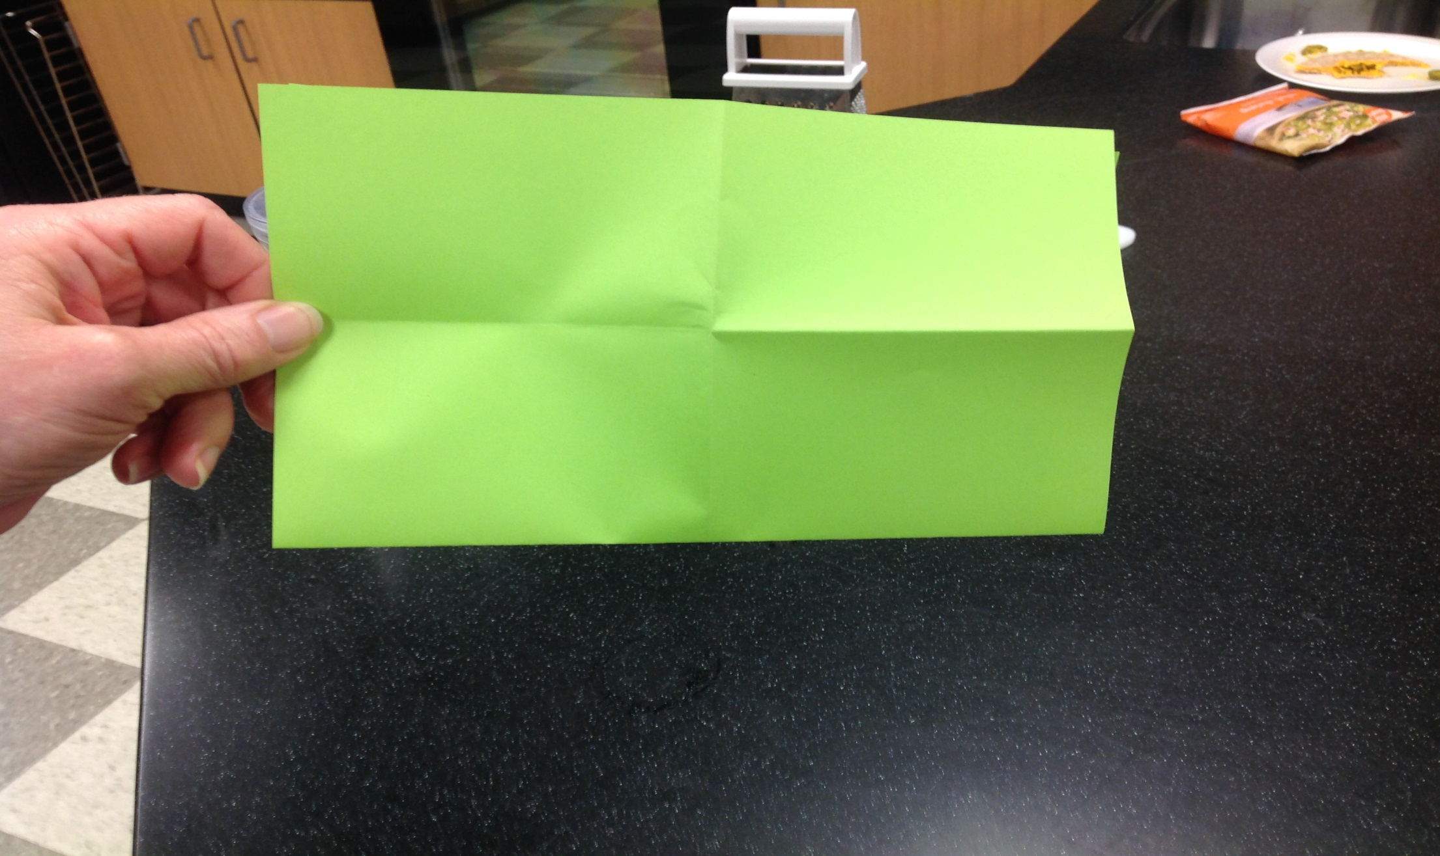
6 – Hold with FOLDED SIDE DOWN

Slide 8
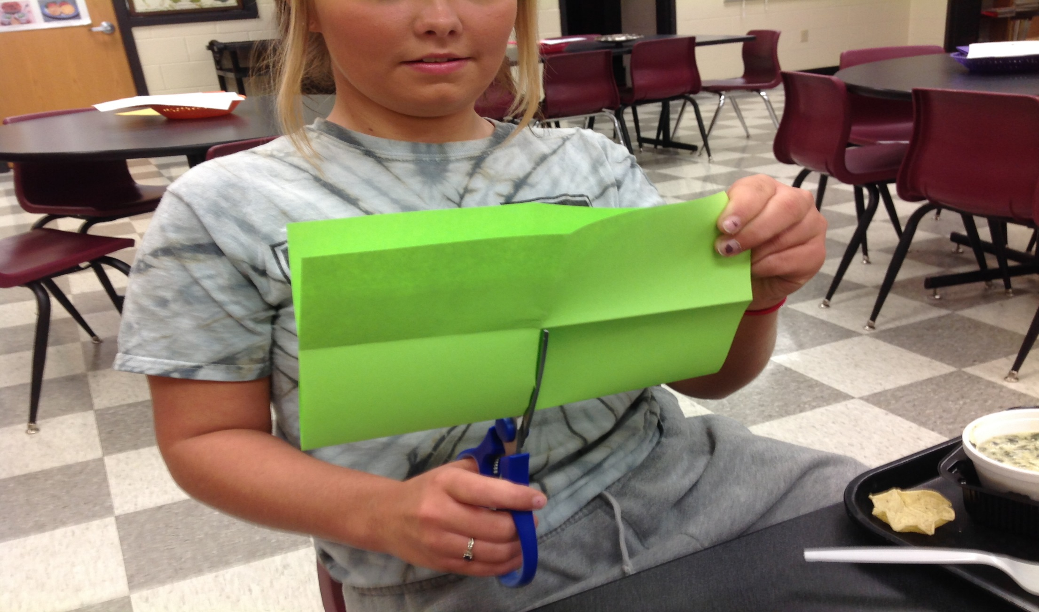
7 – Cut, stopping at the first fold

Slide 9
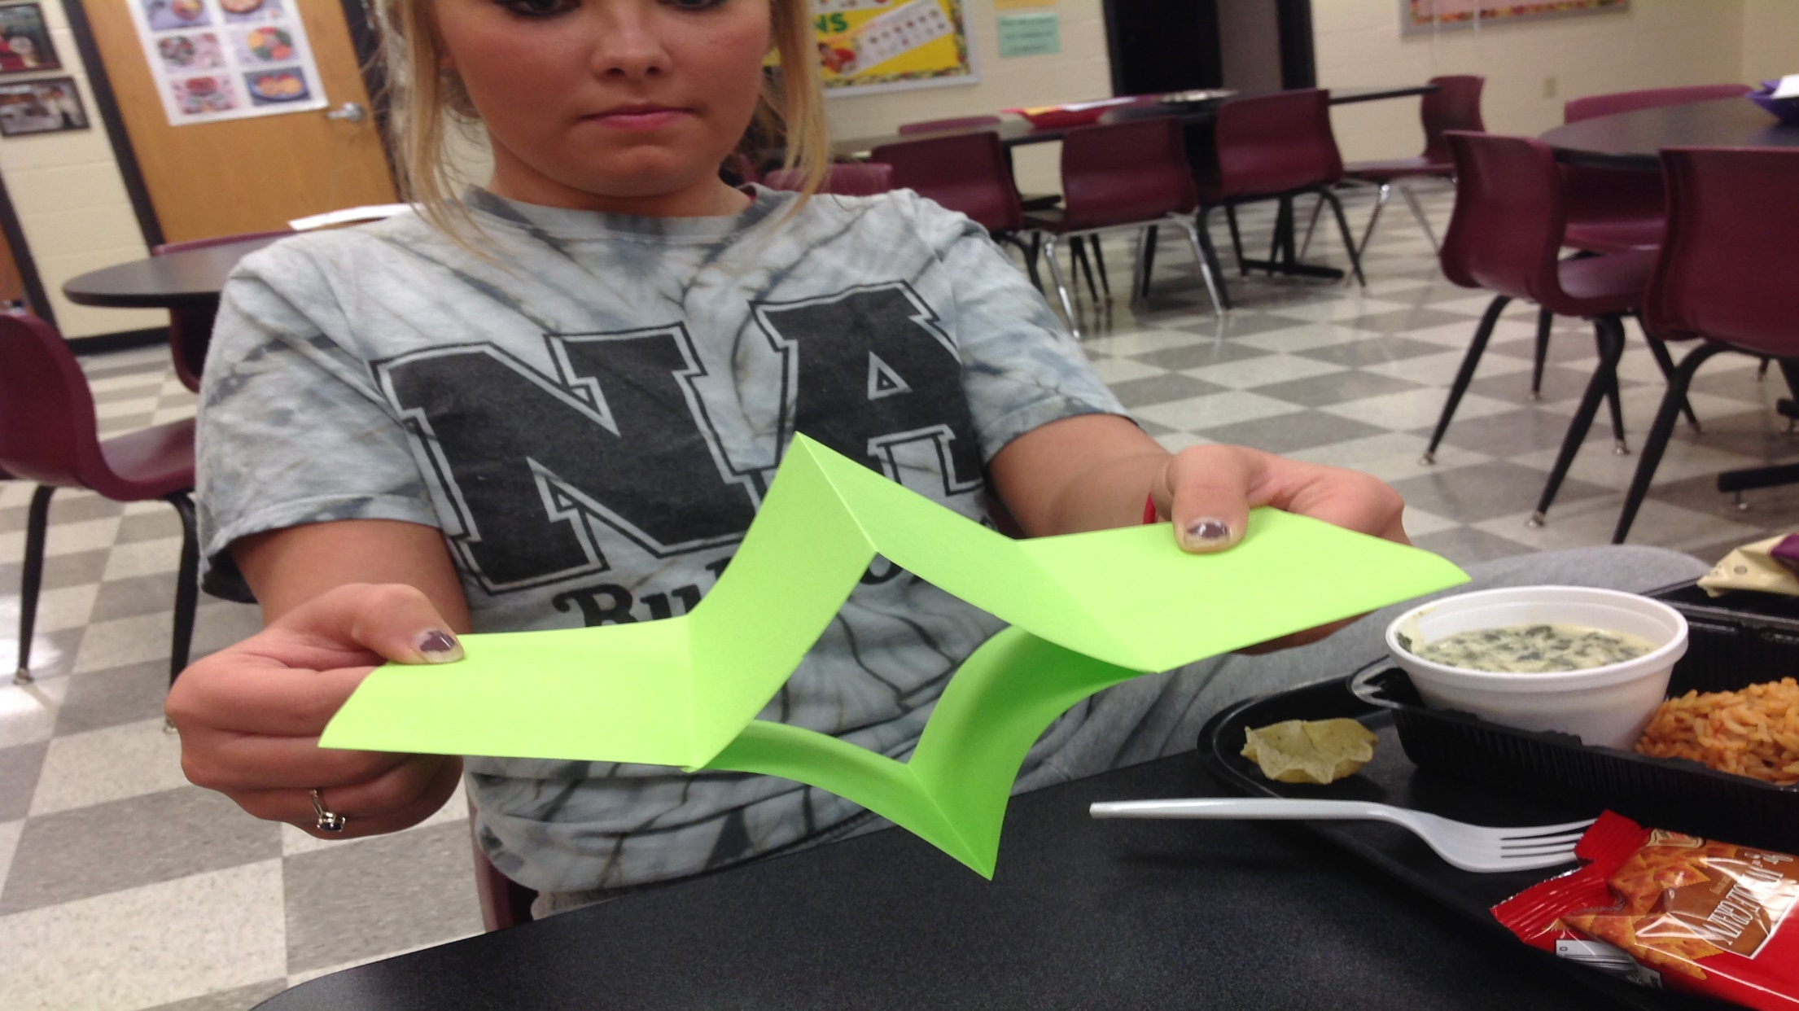
8 – Open and fold like a hot dog…you have fish lips

Slide 10
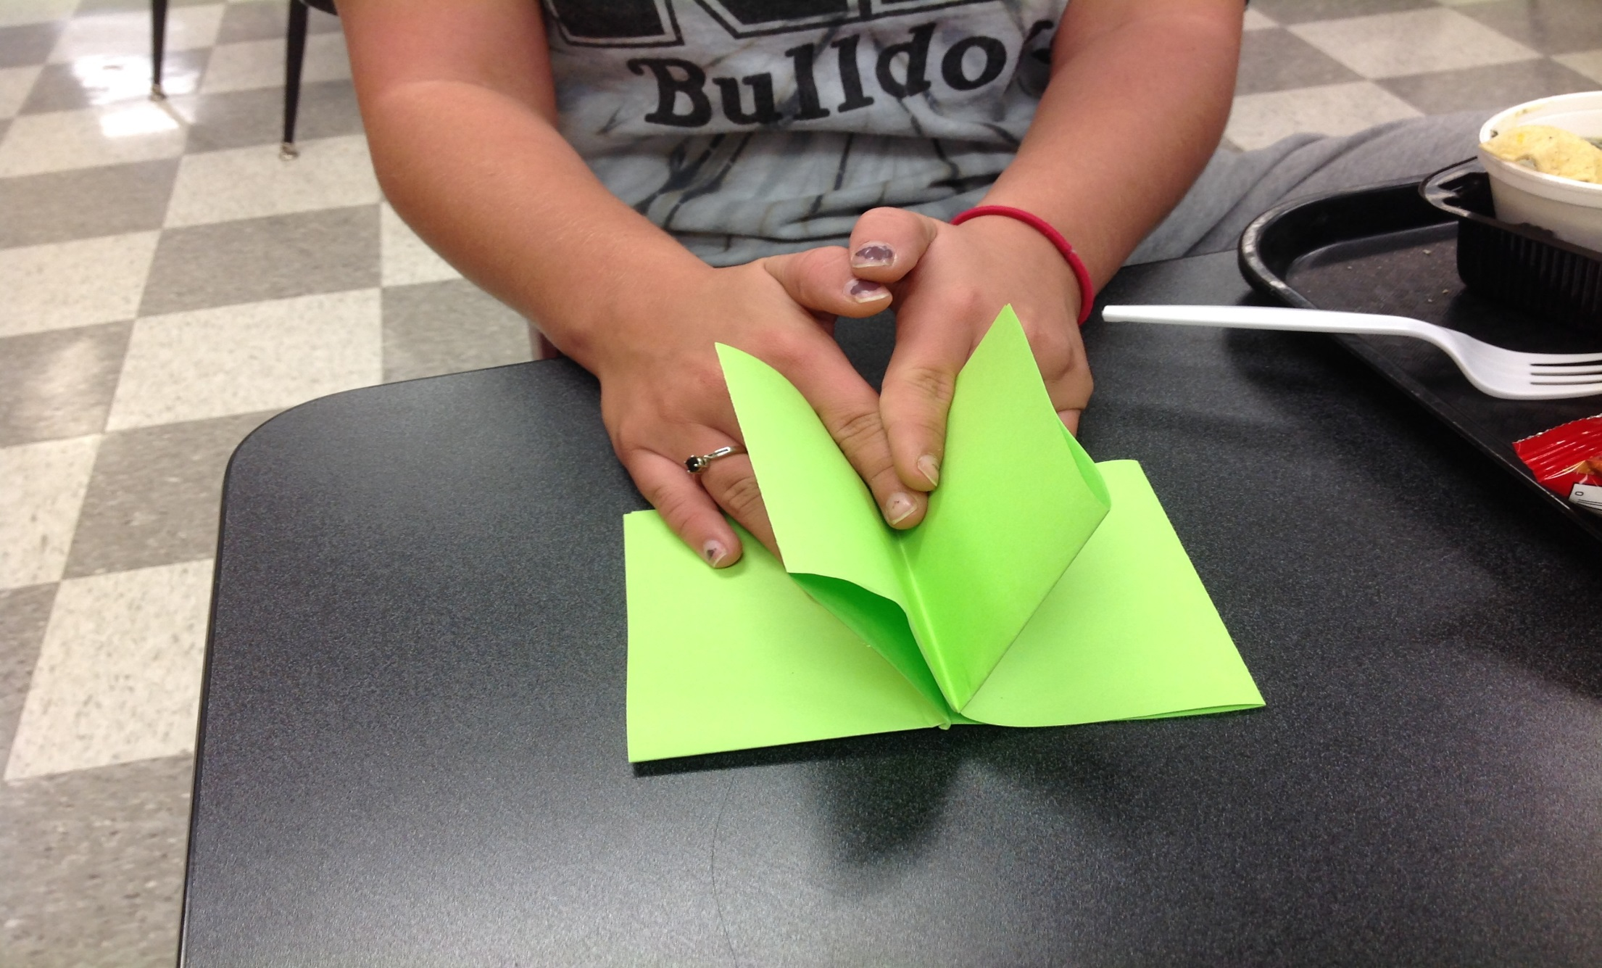
9 – Fold into a book

Slide 11
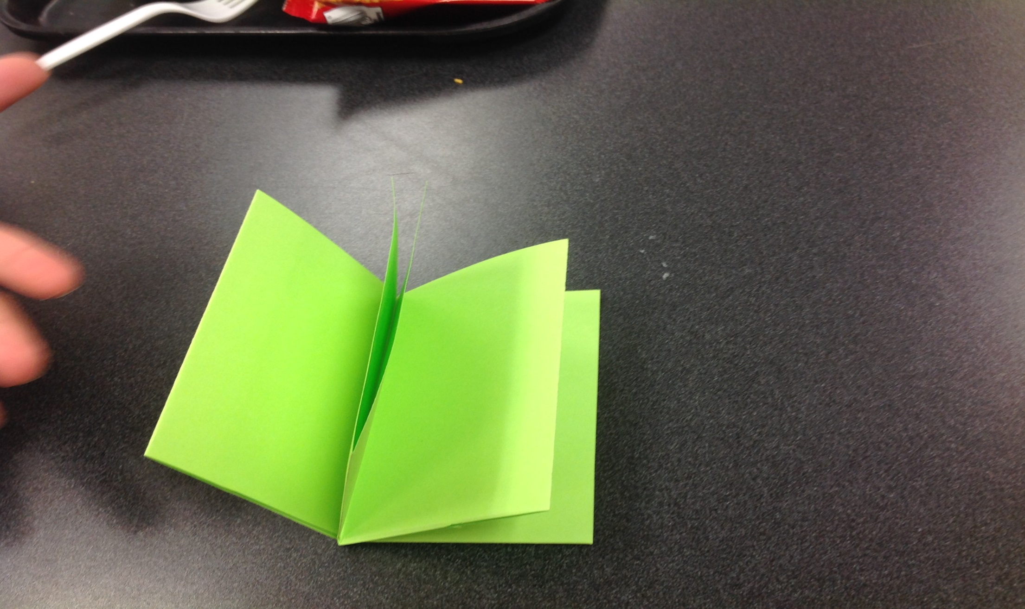
10 – Ready to take some notes☺

