Slide 1
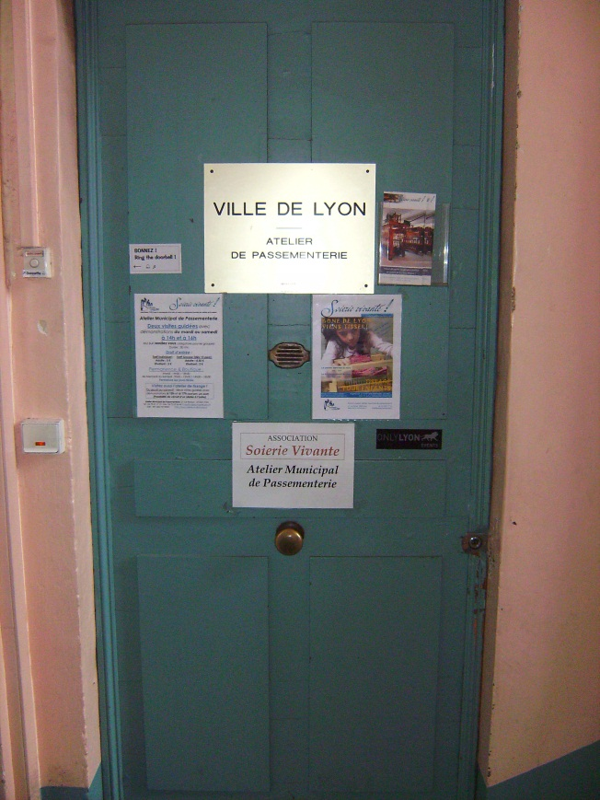
How it’s Made: Silk Trim
Pictures from Lyon, France

Slide 2
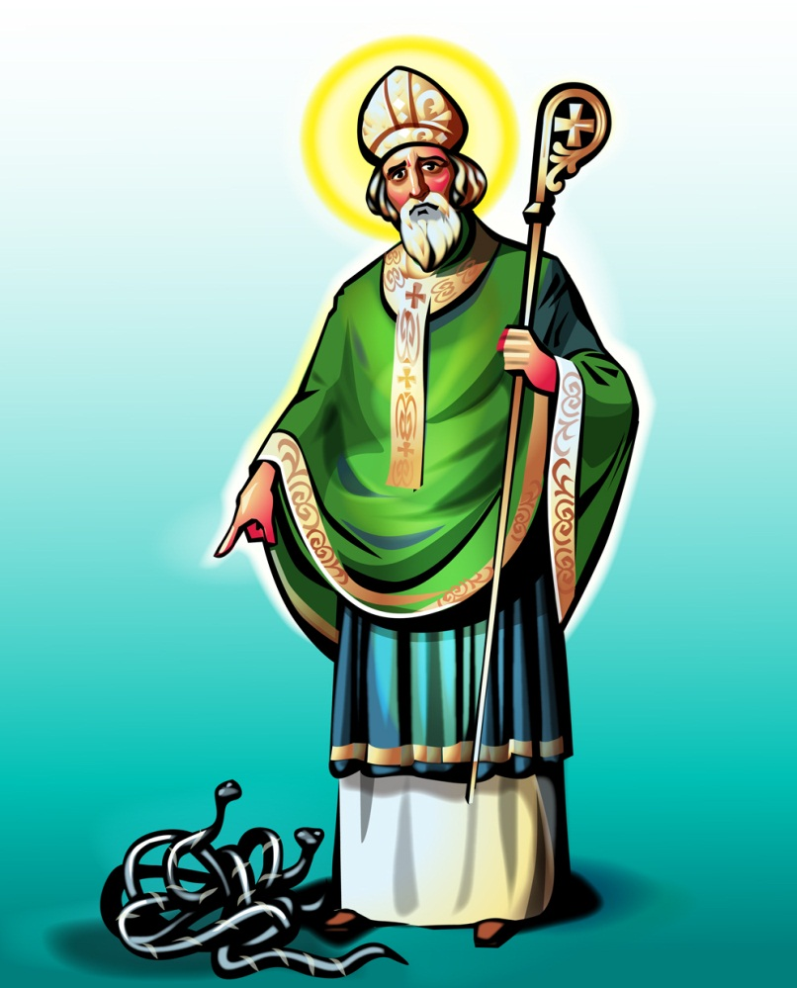
Where does Silk Trim Come from?

Slide 3
Create a Pattern on Graph Paper

Slide 4
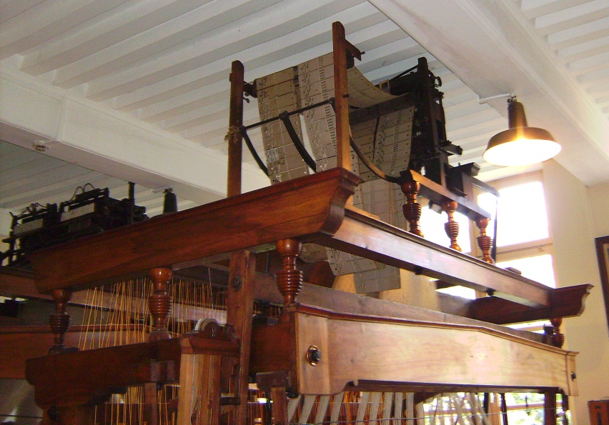
Translate the Design into a Punch Card Pattern

Slide 5
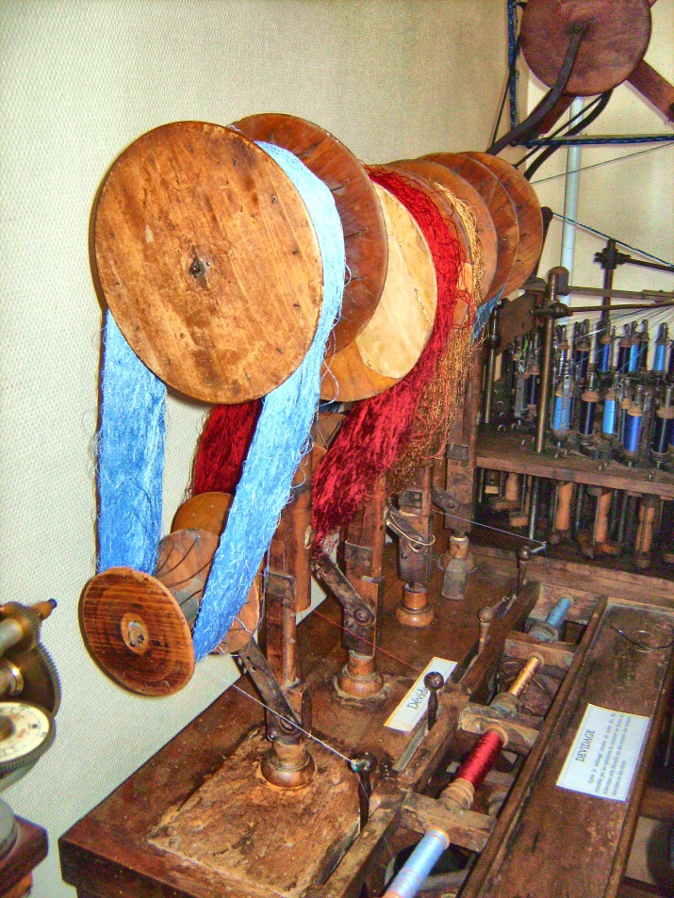
Wind Your Bobbins
Purchase large piles of silk then wind it onto each bobbin
Before the turn of the 20th century real gold and silver thread was used

Slide 6
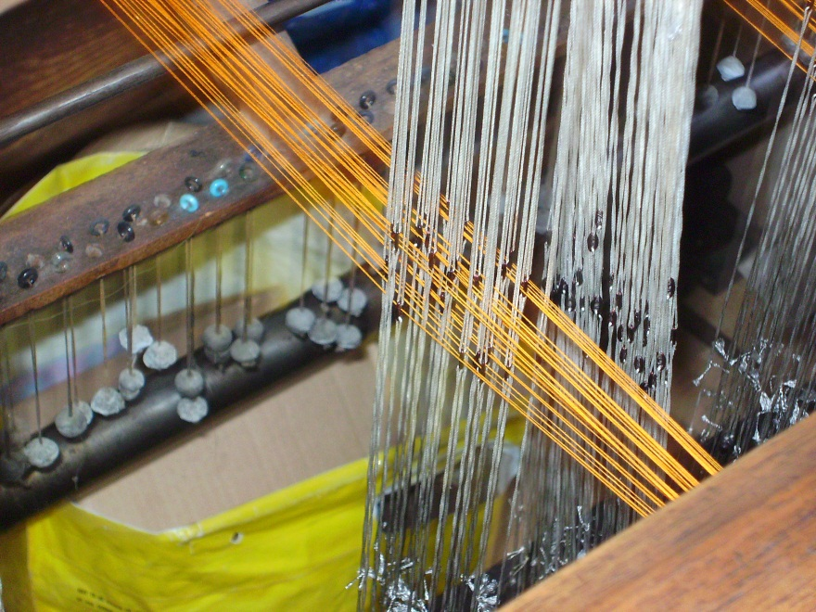
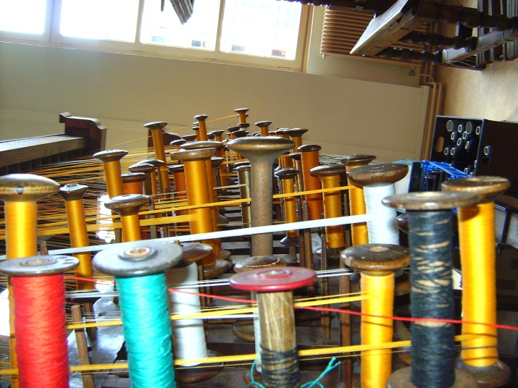
Thread the Loom
I takes days to
thread a loom!

Slide 7
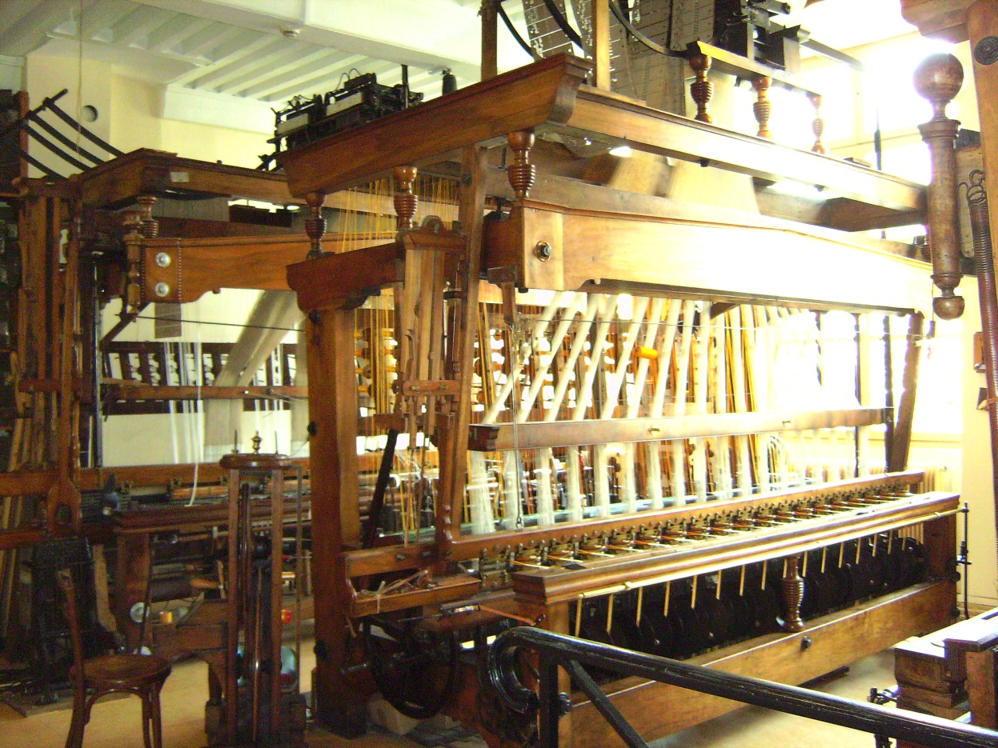
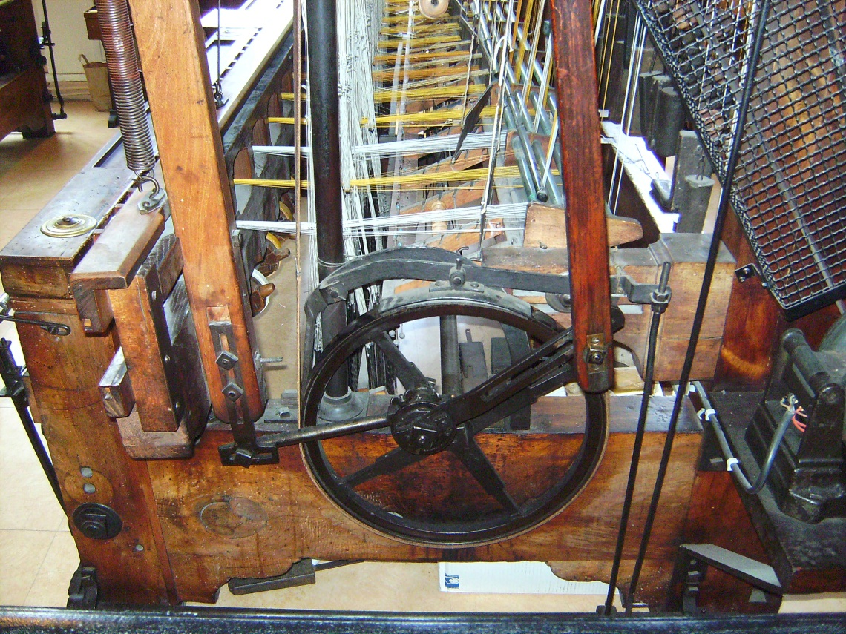
Run the Loom
This loom has a motor but before the motor you had to pull and push to run it by hand.

Slide 8
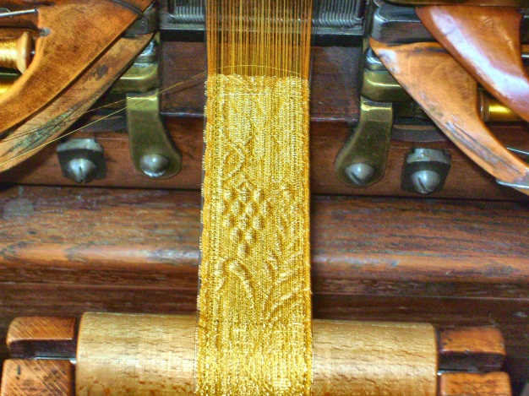
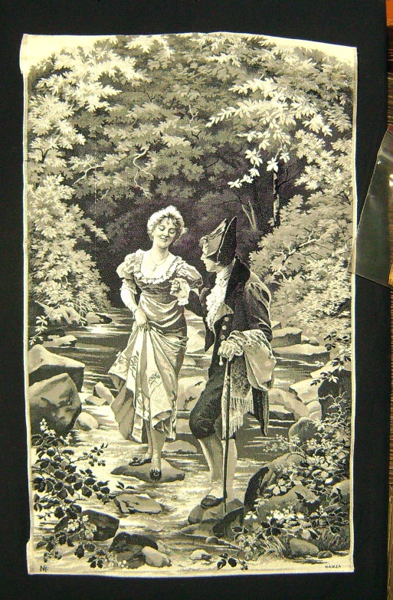
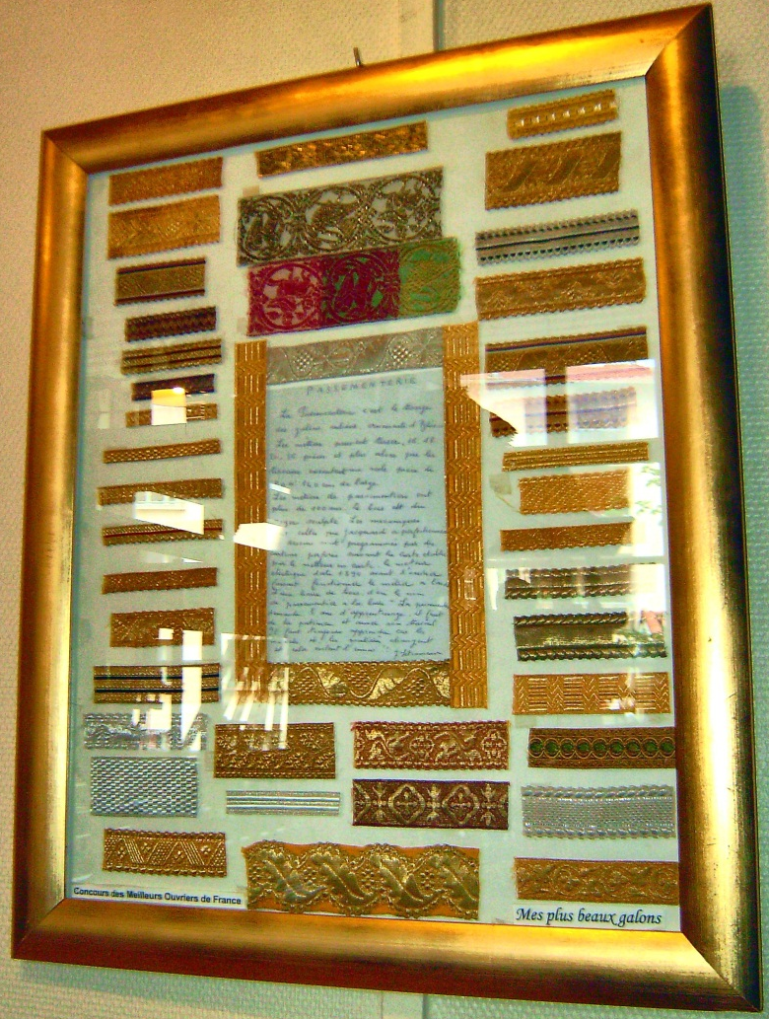
Finished Products
Trim for Catholic
Priest’s robes
Silk Woven Picture

Slide 9
Silk Videos
http://youtu.be/ndvrVlvu3ts
http://youtu.be/JW5mJjEqTvk

