Slide 1
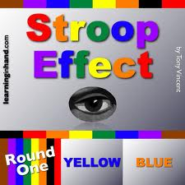
STROOP’S EFFECT EXPERIMENTS

Slide 2
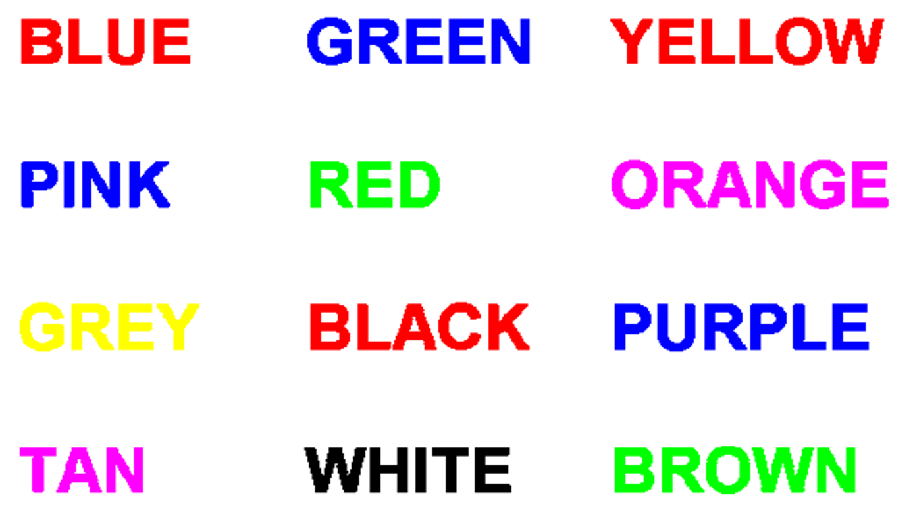
STROOP’S EFFECT

Slide 3
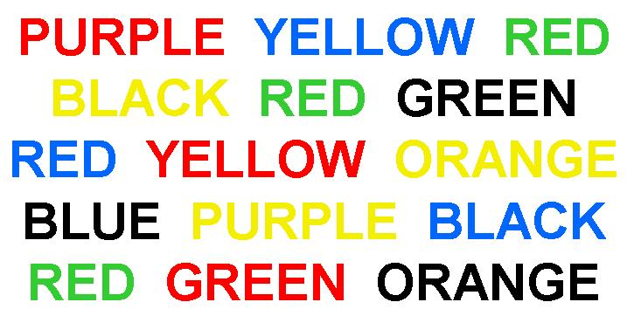
STROOP’S EFFECT

Slide 4
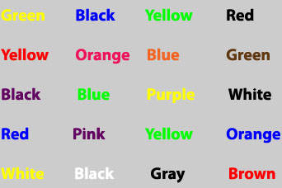
STROOP’S EFFECT

Slide 5
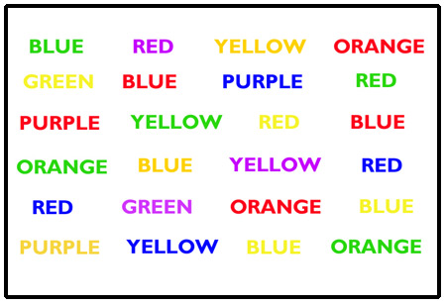
STROOP’S EFFECT

Slide 6
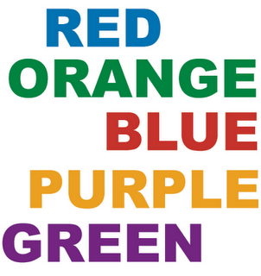
STROOP’S EFFECT

