Slide 1
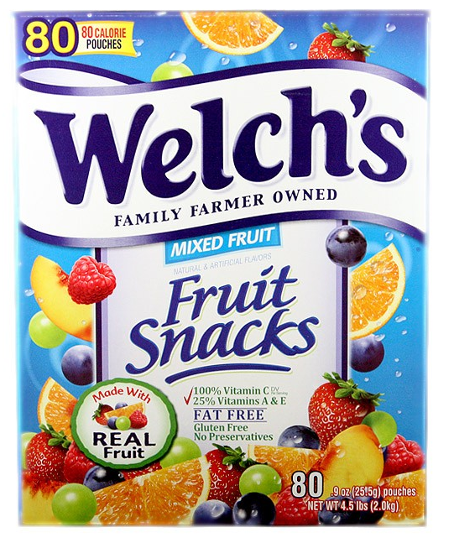
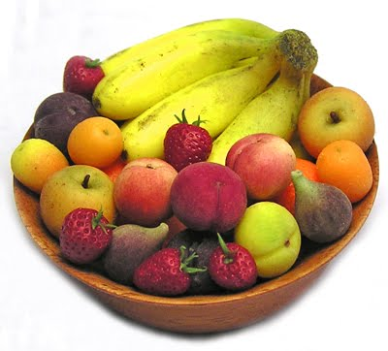
Similarities & Differences

Slide 2
Questions to Consider
Which picture is the whole food?
Which picture is the processed food?
Which has more calories?
Which is more nutritious/healthier?
Which do you tend to eat more of?

Slide 3
SMARTBOARD ACTIVITY
When you are called on, complete one of the following:
Circle a whole food
Draw a line through a processed food

Slide 4
