Slide 1
Patterns of Dating Violence

Slide 2
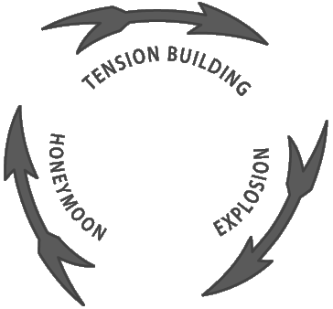
Cycle of Violence

Slide 3
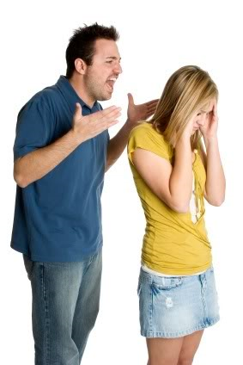
Phase 1: Tension Building
Relationship starts to get tense
More arguing and yelling
False accusations are made
Victim is made to feel
like they can do nothing right

Slide 4
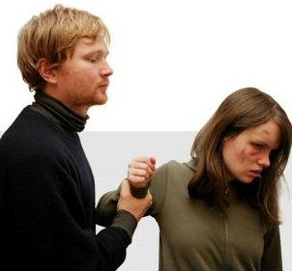
Phase 2: Explosion
Abuse occurs at this stage
Abuse may be physical, emotional/verbal, sexual or digital
Threats to hurt loved ones may also occur

Slide 5
Phase 3: Honeymoon
Abuser apologizes and promises that it’ll never happen again
Abuser says “I love you”
Abuser buys special gifts like flowers or jewelry to make up for what happened
Accuses the victim of causing the abuse
Places blame on someone or
something else

Slide 6
Cycle of Violence
The cycle will get worse…
Abuse will occur more frequently and become more intense/ violent each time
The period of time between the phases will become shorter
Dating violence is not a one time thing…it will happen again

