Slide 1
Infant Vision

Slide 2
Adult Vision vs Newborn Vision

Slide 3
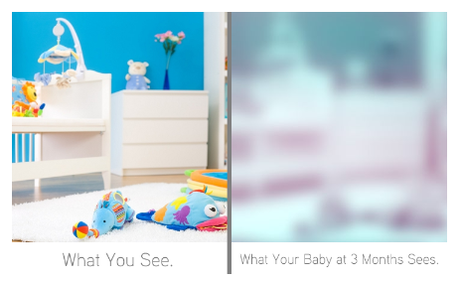
Adult Vison vs 3 Month Infant

Slide 4
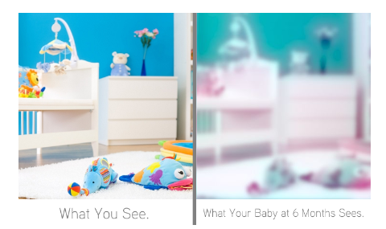
Your Vision vs 6 Month Infant

Slide 5
12 Month Infant
Baby will see exactly what you see.

Slide 6
Understanding Infant Vision
View the following clip
http://video.about.com/babyparenting/Understanding-infant-vision.htm

Slide 7
Learn More About Infant Vison
Complete the graphic organizer relating to infant vision by following the links provided.
Then create a mobile to help stimulate an infant’s vision based on the information found in the articles/websites.

