Slide 1
Impact of Social Media
on
Potential Employment

Slide 2
Social Media
Helpful or Harmful?
Individually create a t-chart brainstorming why social media can be helpful +/or harmful.
Be prepared to share as a group.

Slide 3
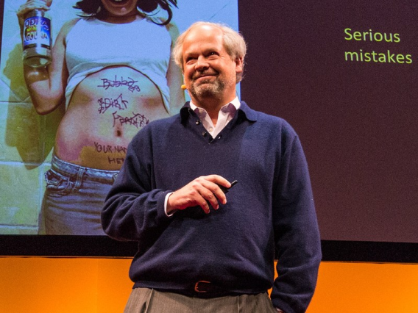
TED Talk
View the TED Talk: Digital Tattoos
https://www.ted.com/talks/juan_enriquez_how_to_think_about_digital_tattoos#t-342404
Identify the four lessons we can learn from the Greeks and one from the Latin’s.

Slide 4
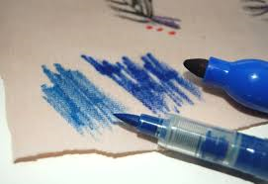
Analogy
Write a solid one paragraph minimum about the analogy between the stained fabric swatch activity and the TED Talk social media clip you just viewed. Explain the lesson(s) to be taken away from them.

Slide 5
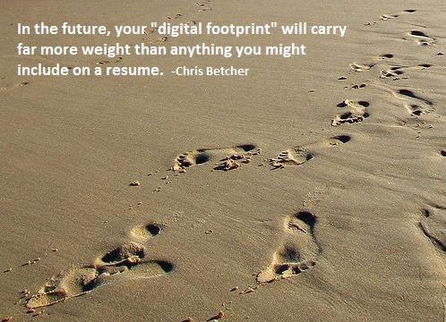
Agree or Disagree?

Slide 6
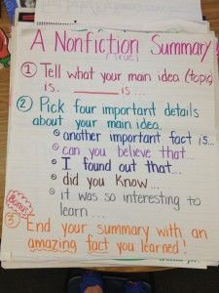
Non-fiction Summary
Guess Who’s Looking at Your Facebook Page?
http://www.thefreelibrary.com/Guess+who's+looking+at+your+Facebook+page%3F-a0385068328
Tell what your main idea (topic) is. __________ is…
Pick four important details about your main idea and use the following transitions to describe them:
Another important fact is…
Can you believe that…
I found out that…
Did you know…
It was interesting to learn…
End your summary with an amazing fact you learned!

Slide 7
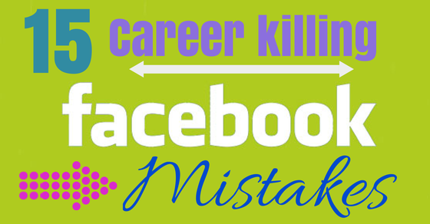
What’s Inappropriate?
Go to the link on the Community Portal to complete the “6 Career Killing Mistakes” assignment.
Identify the mistakes #1-6 in your own words and explain what this means and what you should do to be professional. Use the provided template.
Evaluate your social media use by completing the tally sheet.
6

Slide 8
Infographic Analysis
Analyze the infographic and complete the assignment based on employers using social media to pre-screen potential employees.
http://www.mediabistro.com/alltwitter/social-media-employee-screening_b55256

Slide 9
Why Might an Employer Check?
Looking at a candidate’s personality
Looking at a candidate’s communication skills
Highlights/Accomplishments (things that might set you apart…be sure they are accurate)

Slide 10
What Do Employers Think?
View YouTube clip to get a good idea….
http://www.youtube.com/watch?v=jSdw9m3FskA

Slide 11
What’s Out There About You?
Google yourself and make a list of what comes up.
If you knew an employer was going to view your social media accounts would they find anything posted that could be damaging?
If so, what can be done about it?

Slide 12
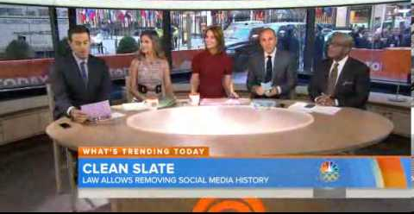
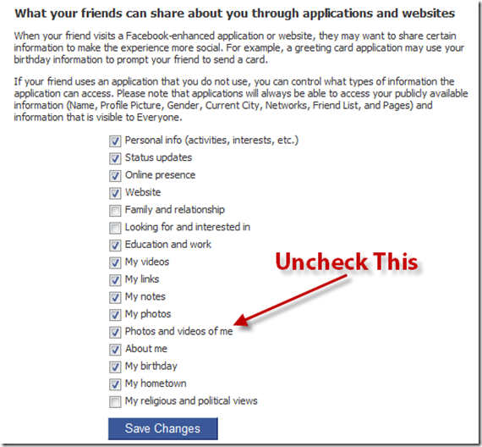
What Can You Do?
Delete It & Be Prepared to Explain if Reposted
Set Up Privacy Walls
Un-tag Yourself from Inappropriate Photos
Teen Eraser Law (depending on state)

Slide 13
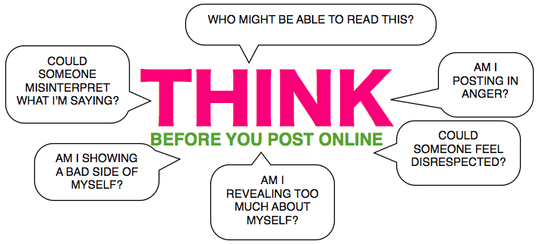
Remember…
Social Media can be a valuable networking tool to connect with not just family and friends, but colleges and future/present employers….so THINK before you post!

Slide 14
Conclusions:
http://www.forbes.com/sites/jacquelynsmith/2013/04/16/how-social-media-can-help-or-hurt-your-job-search/ (Article)
OR
http://www.wbir.com/video/2516206845001/1/Helpful-or-harmful-Social-media-impact-on-job-search (Video Clip)

Slide 15
Final Assignment: Complete Both
Do you think that employers should have access to potential employees’ social media accounts? Explain
Describe how you would respond to a similar request when applying for a job? Explain.
Length: As long as it needs to be to completely answer the questions!

