Slide 1
Foldables

Slide 2
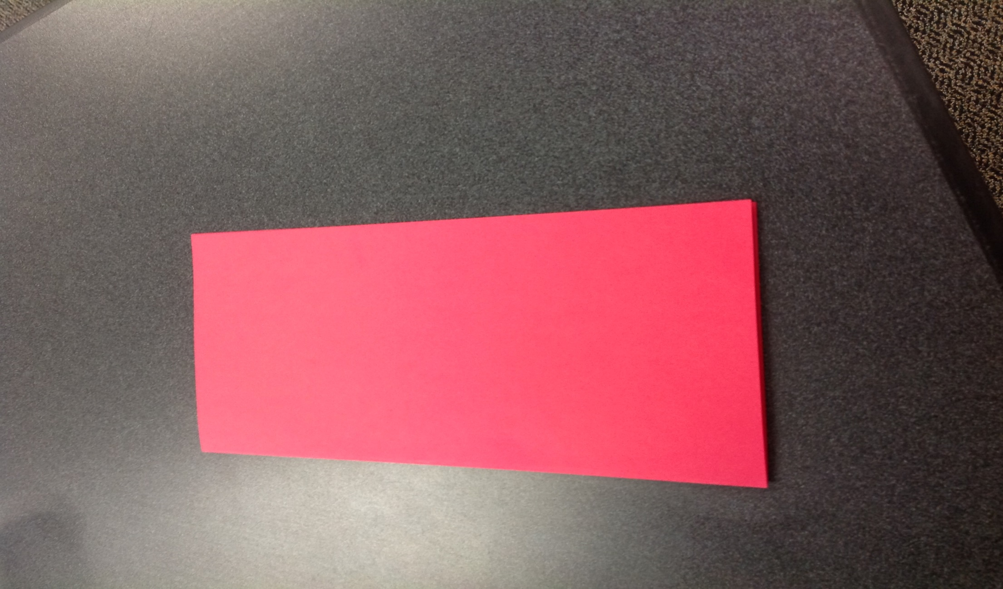
Step 1 – Fold SQUARE in half

Slide 3
Step 2 – fold in half again

Slide 4
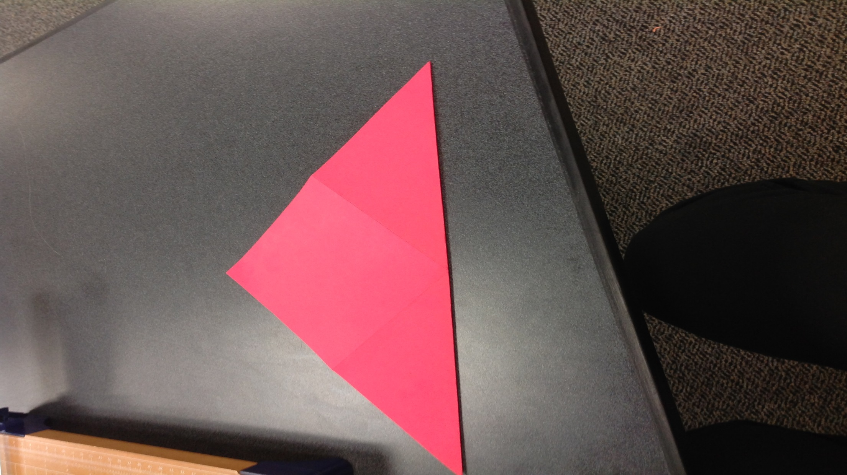
Step 3 – fold diagonally

Slide 5
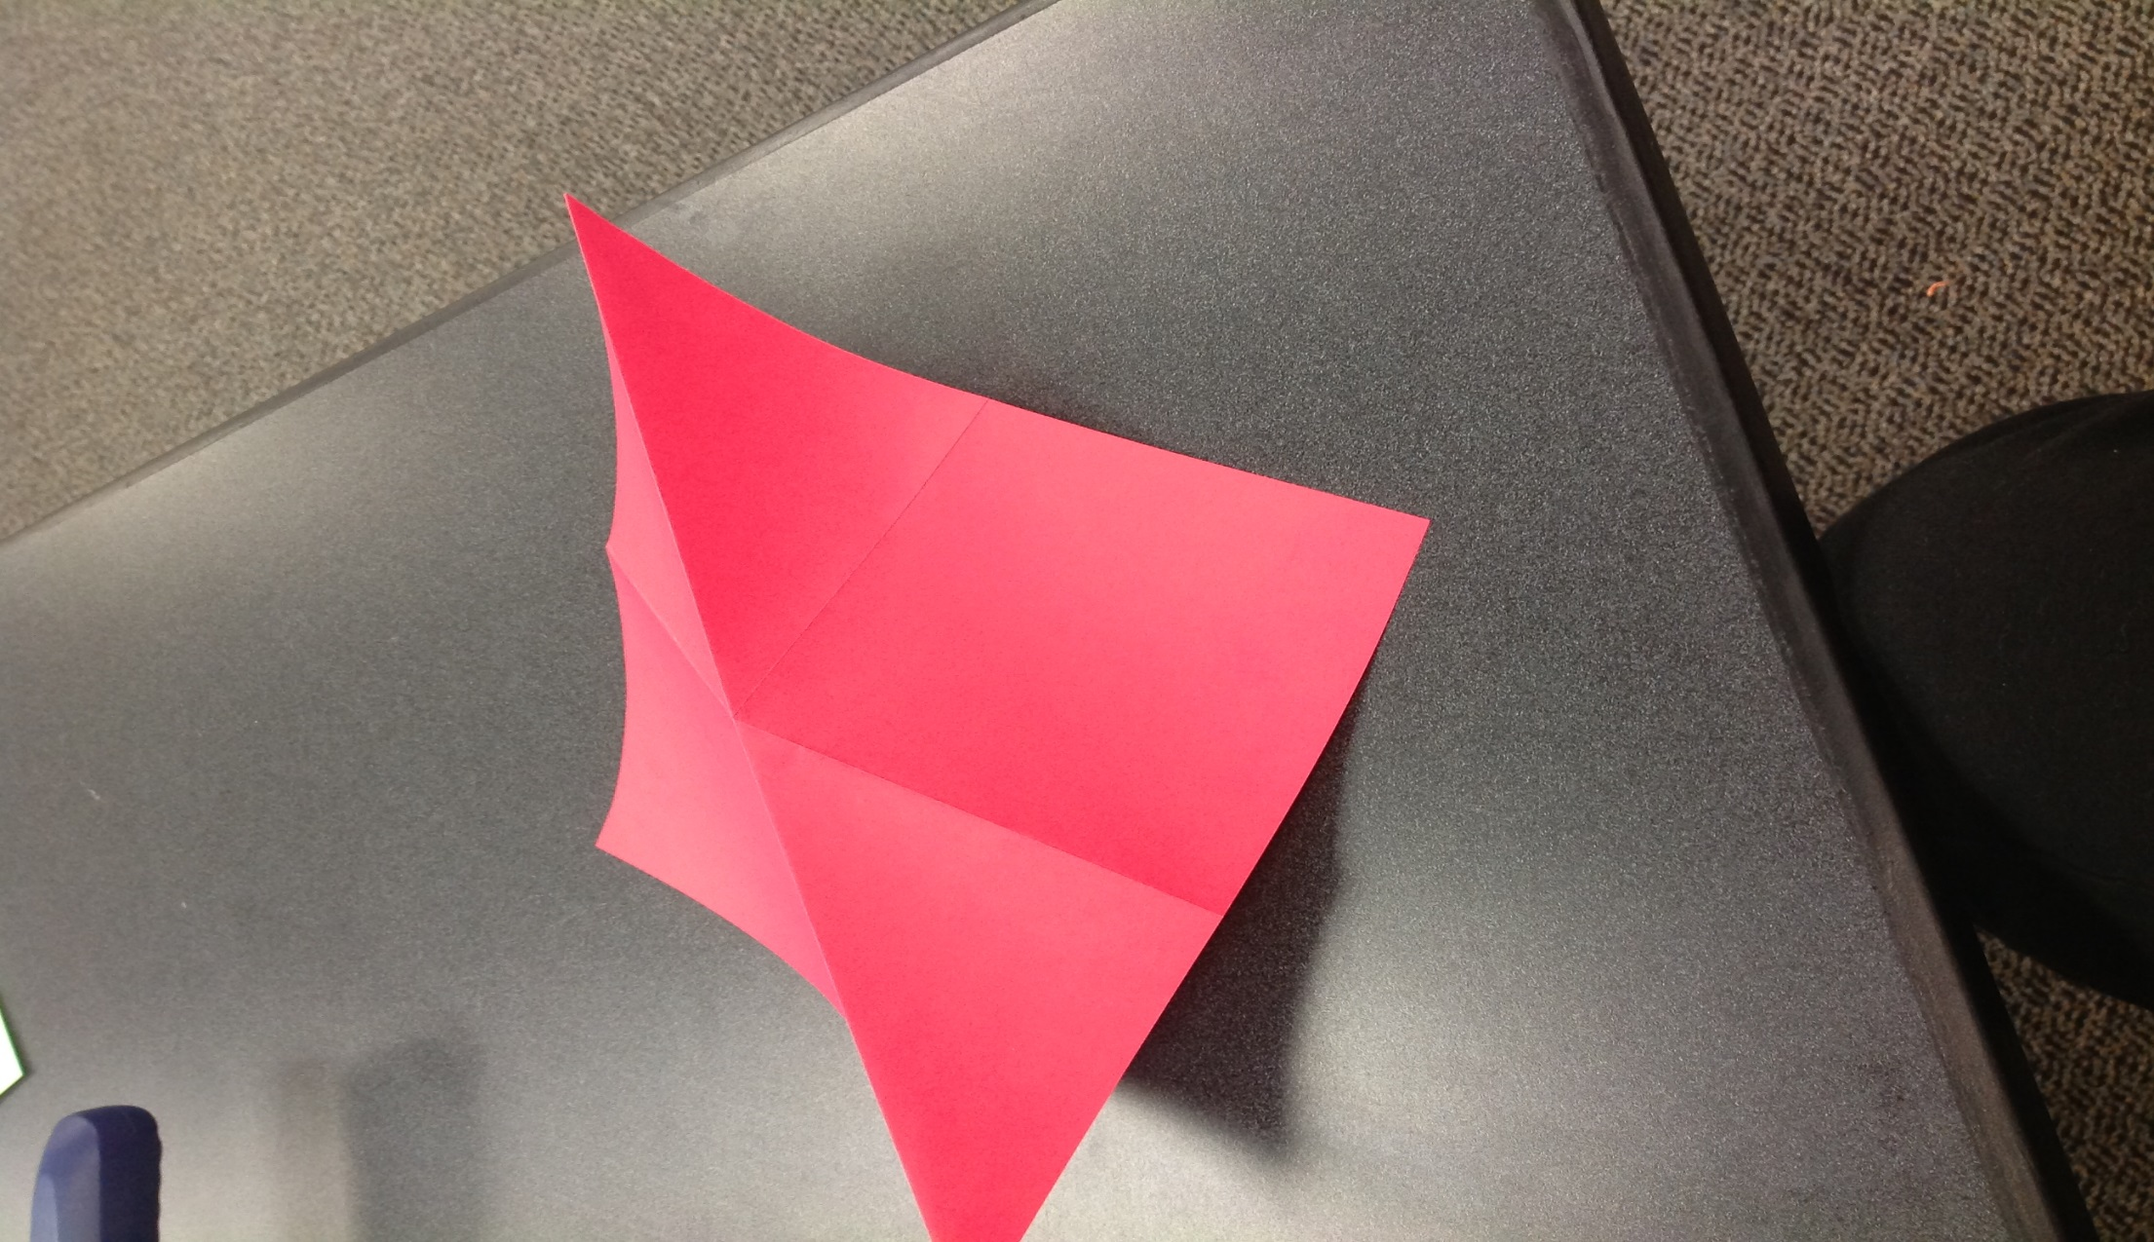
Step 4 – place diagonal fold up (like a tent)

Slide 6
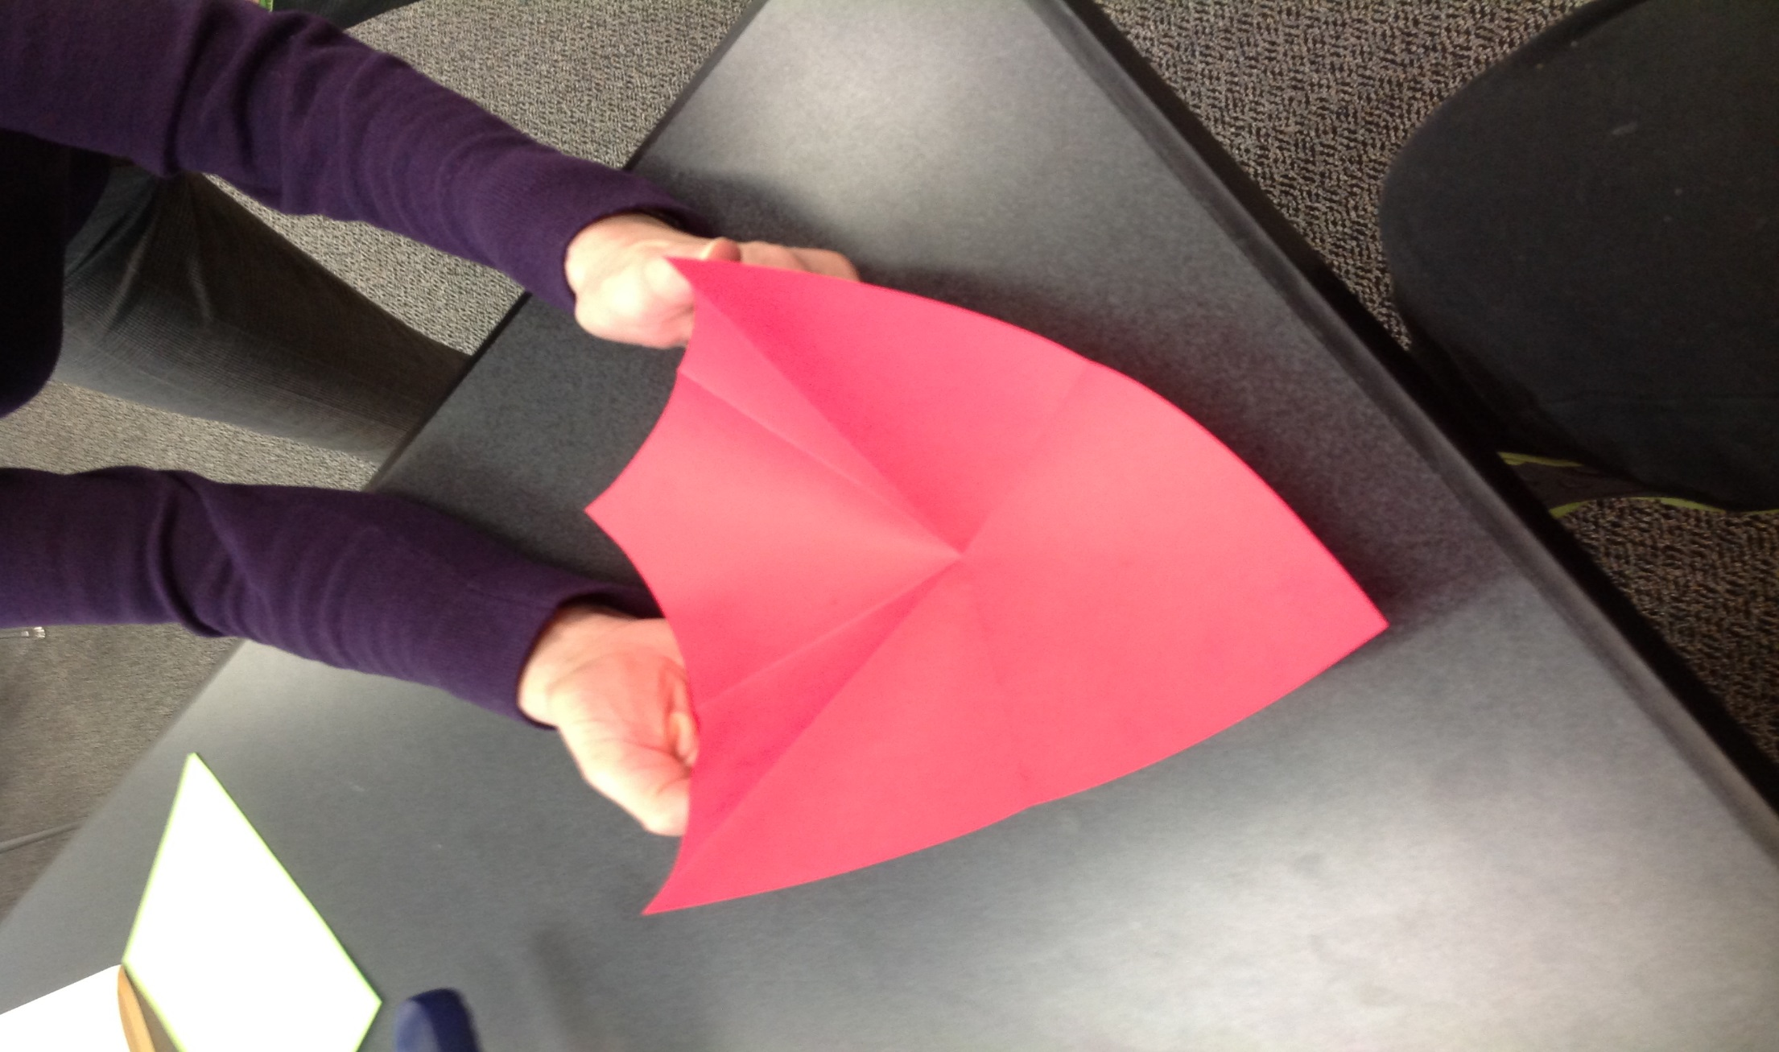
Step 5 – bend into a cup

Slide 7
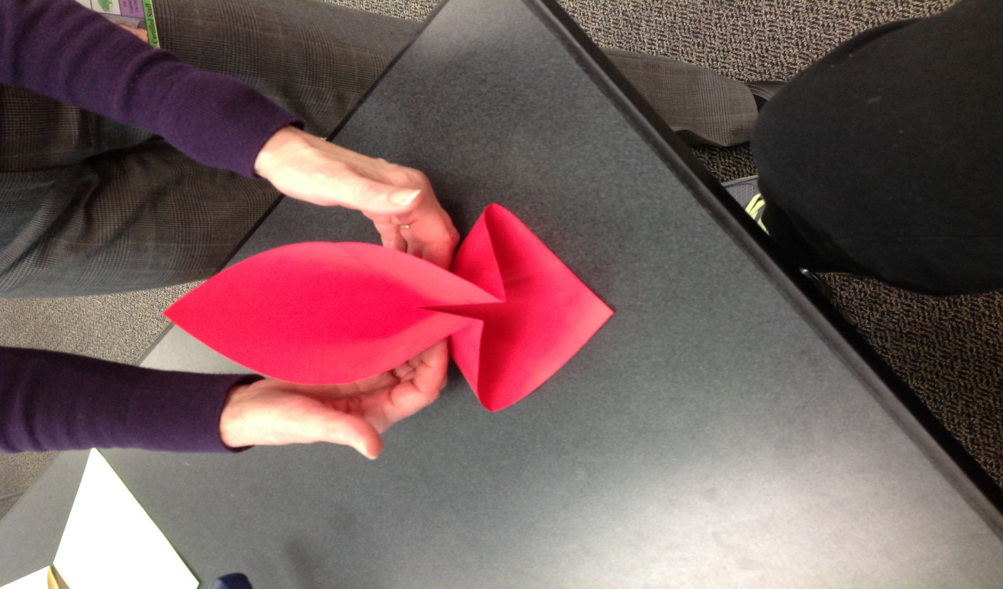
Step 6 – Push in sides

Slide 8
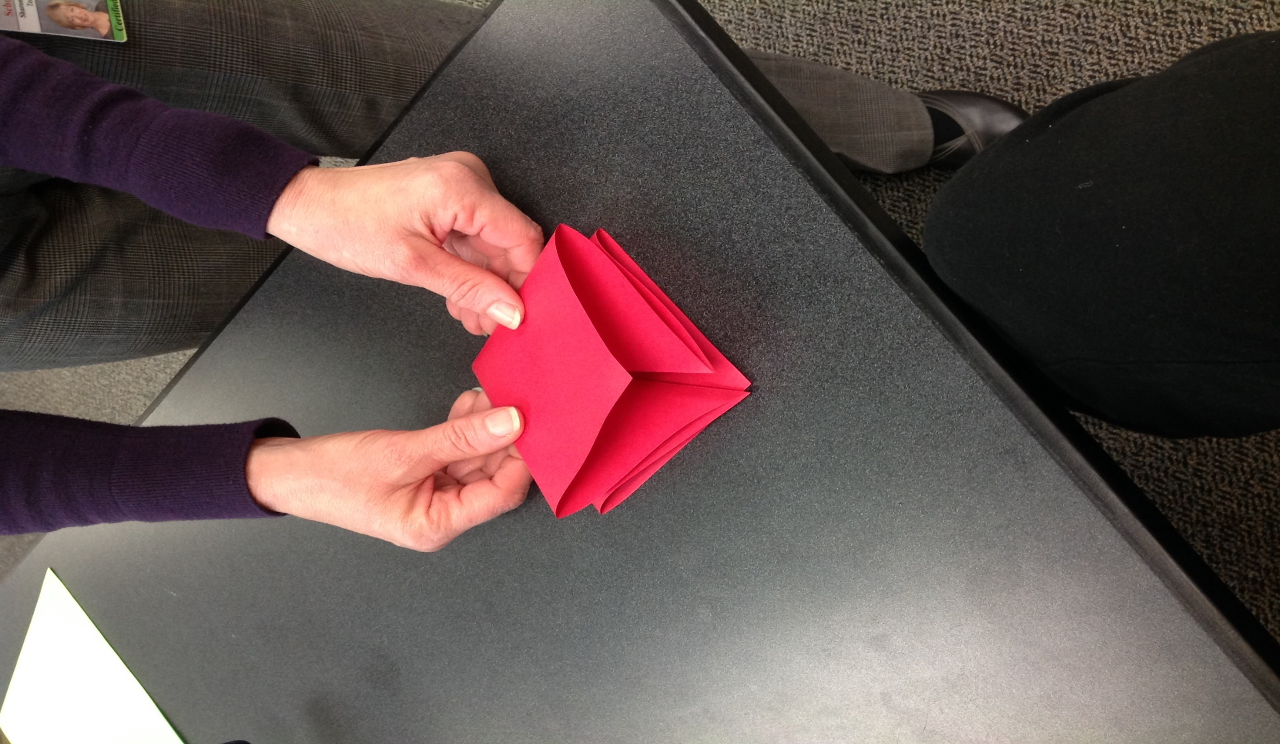
Step 7 – Fold into a square

Slide 9
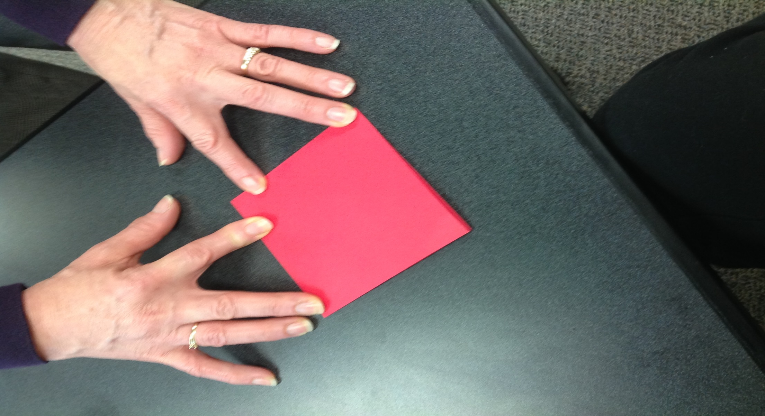
Step 8 – fold flat

Slide 10
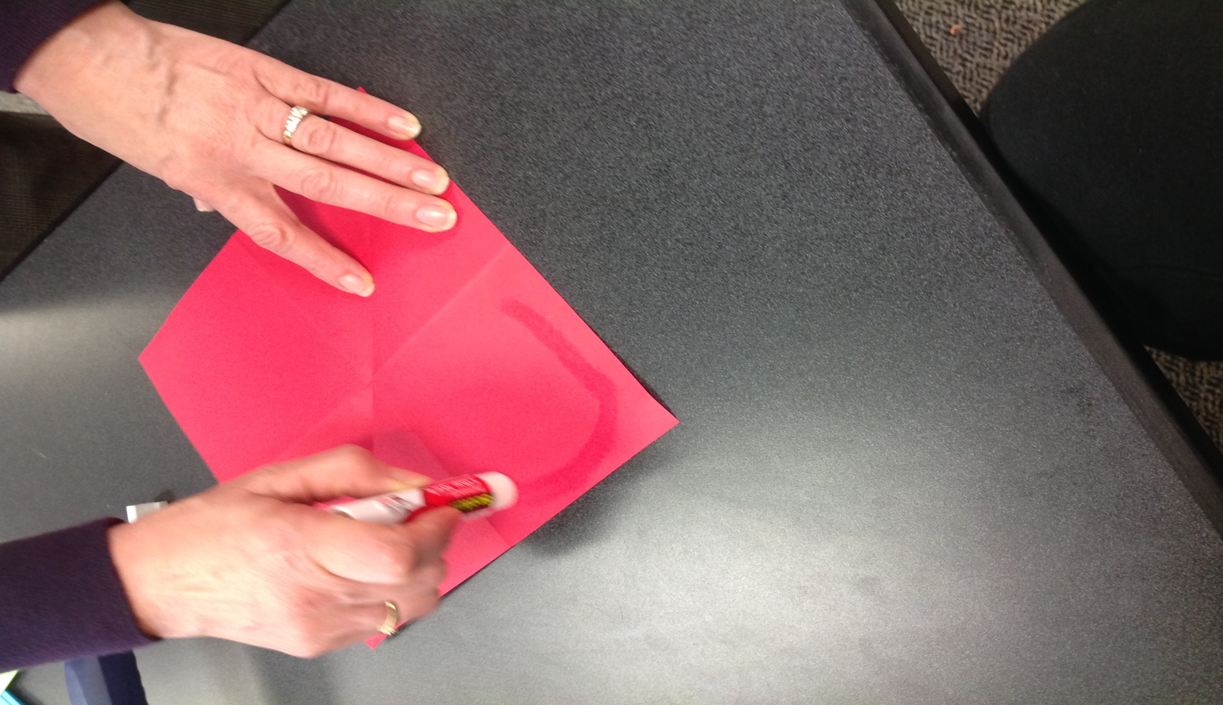
Step 10 – Glue one side of a square

Slide 11
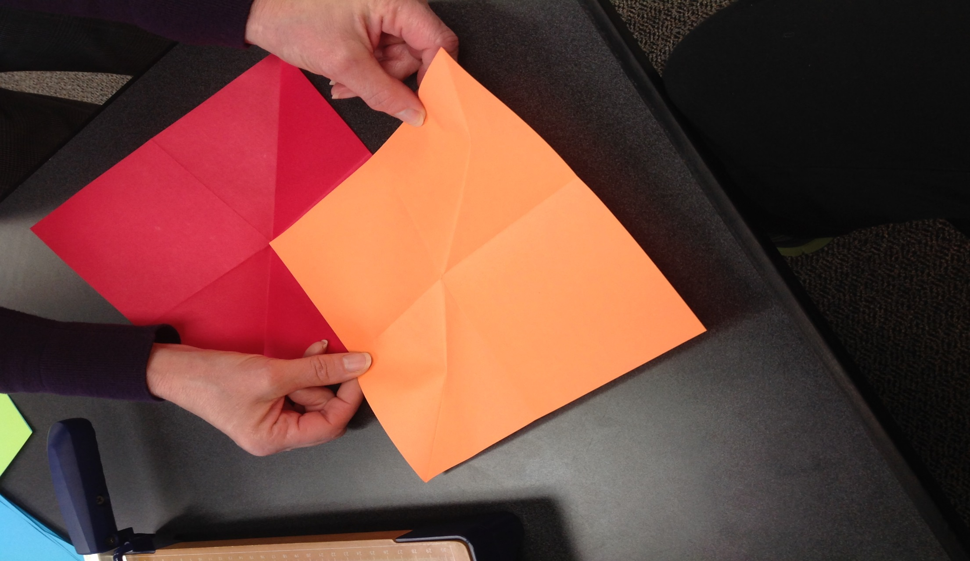
Step 11 – Glue squares together

Slide 12
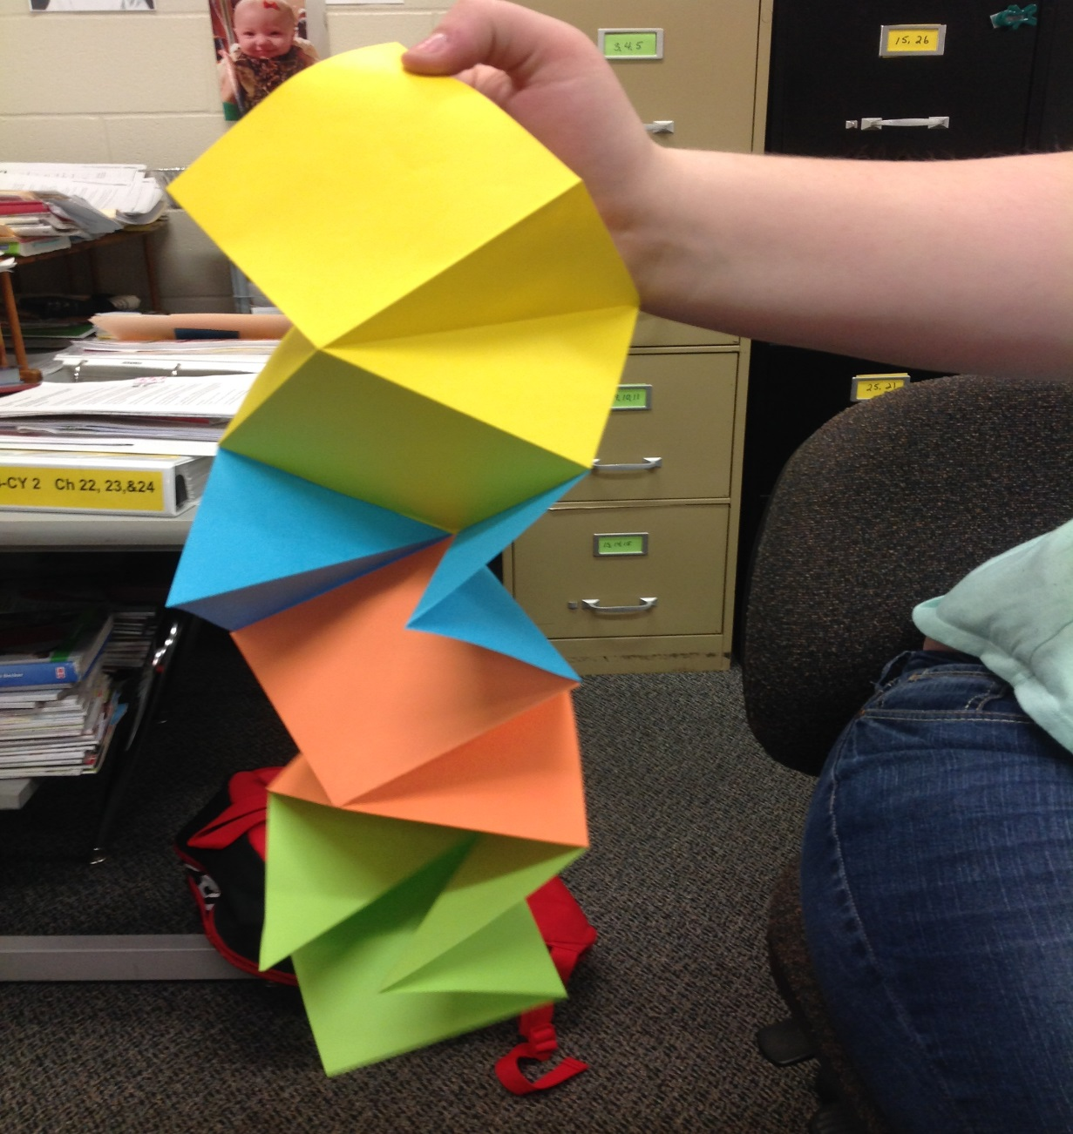
Step 12 – Finished Product!

